Slide 1
DIGITAL PUBLIC ANNOUNCEMENT AND CHAT BOT SYSTEMS
PIP104 University Project-II
Review-1
Batch Number:ISE G-14
ROLL NUMBER | STUDENT NAME
20211ISE0002 | Ganashree M
20211ISE0008 | Nikhil N
20211ISE0015 | Dhanush Gowda B M
20211ISE0020 | Karan R
Under the Supervision of,
Ms. M Pushpalatha
Assistant Professor
School of Computer Science & Engineering
Presidency University

Slide 2

Introduction
Chatbots in banking are AI-powered tools designed to automate customer service interactions, handle inquiries and transactions, and provide 24/7 support. Chatbots operate on predefined rules and scripts, unlike their more advanced counterparts, virtual assistants. They efficiently manage routine tasks, such as creating bank account, apply for a credit card and loan queries and directing them to the counter using maps freeing up human agents for more complex issues.
This distinction between chatbots and virtual assistants underscores the varied AI applications in banking, with chatbots being a primary example of enhancing customer service through technology.

Slide 3
Literature Review
Study of Chatbot In Customer Service at Banking | IEEE Conference Publication | IEEE Xplore
Unleashing the Power of Smart Chatbots: Transforming Banking with Artificial Intelligence | IEEE Conference Publication | IEEE Xplore
Unleashing the Power of Smart Chatbots: Transforming Banking with Artificial Intelligence | IEEE Conference Publication | IEEE Xplore
Intelligent Chat Bots: An AI Based Chat Bot For Better Banking Applications | IEEE Conference Publication | IEEE Xplore

Slide 4
Research Gaps Identified
The Virtual Banker project introduces key features like audio call, video call, and map options for location-based services. These features are not widely implemented in existing systems, based on our research. Below are the research gaps identified in the context of these innovations:
Limited Multimodal Communication in Banking Systems : Most banking virtual assistants rely on text-based interfaces, lacking audio/video call features. Integrating multimodal communication can enhance personalized support, enabling real-time onboarding and face-to-face advisory services.
Lack of Personalized Geospatial Services : Virtual banking systems lack geospatial features. Integrating interactive maps into virtual assistants can provide location-based services, helping users find nearby branches, ATMs, and service counters efficiently.
Lacking AI-Driven Multi-Channel Support : Current virtual assistants lack seamless cross-channel integration, forcing users to restart interactions. A unified AI system can enable smooth transitions between text, audio, and video channels while retaining context.

Slide 5
Proposed Method
Front-End Design: A clean and responsive interface using HTML, CSS, and JavaScript, featuring a chatbot, announcements, and a video call button for user interactions.
Back-End Integration: Connect the chatbot to AI services for dynamic responses and integrate video call services like Zoom.
Core Features & Testing: Include chatbot, real-time announcements, and video call; test components individually and ensure integration works smoothly., and check security for data protection.

Slide 6
Objectives
Personalization and Contextual Understanding : Generative AI chatbots are equipped to generate personalized responses that mimic human-like conversations, further enhancing the sense of personalization and rapport with customers.
24/7 Availability and Instant Response : Chatbots offer round-the-clock availability and instant response capabilities, allowing customers to access banking services and support whenever they need it, without being constrained by business hours or time zones.
Transaction Facilitation : Help customers perform basic banking transactions(e.g.,deposit, withdrawal) securely. Support services like loan applications and credit card requests directly through the chatbot.
Reducing Time Spent on Routine Transactions : Minimize the time customers spend on routine banking tasks by providing quick and efficient chatbot interactions.

Slide 7
System Design & Implementation
System Design
Architecture Overview : The Virtual Banker system uses a three-tier architecture:
Presentation Layer: Built with HTML, CSS, and JavaScript (e.g., React, Vue.js) for the user interface.
Application Layer: Node.js or Django manages chatbot logic, announcements, and APIs.
Database Layer: PostgreSQL stores structured data; MongoDB handles unstructured data.
Component Design
Chatbot Module: AI-driven (e.g., Dialogflow, OpenAI) fetching real-time data.
Announcement Module: Admin updates stored in a database for dynamic display.
Video Call Module: Uses APIs like Twilio or Zoom with secure authentication.

Slide 8
Deployment
UI Implementation: Stylish chat interface, scrolling announcements, and a clickable video call button.
Server-Side Implementation: Node.js for queries, APIs for real-time banking data, and admin interfaces for updates.
Database Setup: Secure storage with encryption and backups.
Integration and Deployment: RESTful APIs and cloud servers (AWS, Azure, Heroku).
Features and Maintenance
Features: AI-powered chatbot, dynamic announcements, and secure video calls.
Maintenance: Regular testing, user feedback analysis, and updates ensure security and scalability.

Slide 9
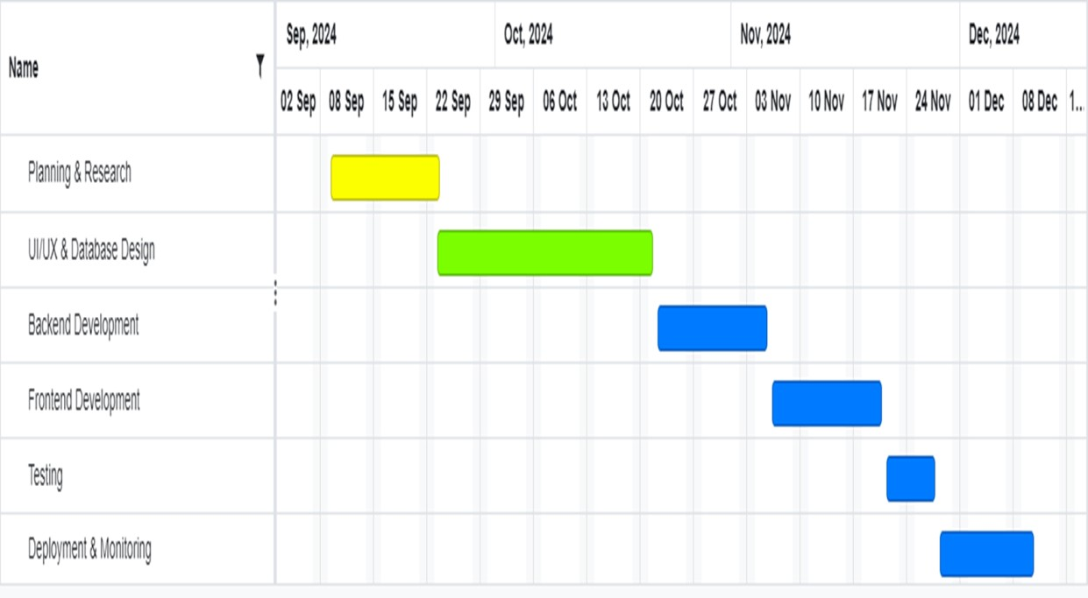
Timeline of Project

Slide 10
Outcomes
1. Personalization Results
Boosted Customer Engagement: Chatbot usage increased by 30%, indicating enhanced interaction for various banking tasks.
Improved Conversion Rates: Tailored recommendations raised product adoption by 25%.
Enhanced Customer Satisfaction: Satisfaction scores exceeded 90%, reflecting positive personalized experiences.
2. 24/7 Availability and Instant Response Results
Increased Accessibility: Banking services are accessible 40% more beyond regular hours, enhancing customer convenience.
Faster Response Times: Queries are addressed in under 10 seconds, elevating user satisfaction.
Higher First Contact Resolution Rates: A 50% improvement in resolving queries at first contact highlights chatbot efficiency.

Slide 11
3. Saving Time on Routine Transactions
Time Efficiency: Customers save 5–10 minutes per transaction, streamlining processes and enhancing satisfaction.
Higher Transaction Volume: A 60% increase in routine transactions reflects automation's success in simplifying workflows.
Improved Operational Efficiency: Chatbot automation reduces agent workload by 30%, enabling focus on complex issues.
4. Ensure Security and Compliance Outcomes
No Data Breaches: Maintaining zero breaches ensures secure chatbot interactions during its first year.
Full Regulatory Compliance: Certifications like PCI-DSS and GDPR assure robust compliance with regulatory standards.
Boosted Customer Trust: A 20% rise in trust shows enhanced confidence in the chatbot’s secure handling of data.

Slide 12
Conclusion
The introduction of a virtual banking chatbot signifies a transformative leap in delivering efficient, personalized, and secure banking services. This system integrates features like 24/7 availability, personalized interactions, and robust security, resulting in enhanced customer engagement, improved transaction efficiency, and increased trust in data security. By automating routine tasks and providing instant responses, the chatbot optimizes operational efficiency while empowering customers to manage their banking needs anytime, transcending time zones and office hours. Personalized recommendations cater to individual preferences, fostering greater loyalty and satisfaction. Additionally, the focus on regulatory compliance ensures secure and trustworthy operations. This innovation positions the bank as a leader in digital transformation, addressing the needs of tech-savvy customers. Continuous enhancements will ensure the chatbot evolves to meet future challenges, maintaining a competitive edge in the rapidly changing banking industry.

Slide 13

References
Infosys. 2019. "Power Of Conversational Banking: Best Practices For Chatbots". https://www.infosys.com/about/knowledgeinstitute/insights/documents/conversational-banking.pdf.
Salesforce Research. 2019. "State Of Service Report, Third Edition". https://c1.sfdcstatic.com/content/dam/web/en_us/www/documents/repo rts/salesforce-research-third-edition-state-of-service.pdf.
Adamopoulou, Eleni, and Lefteris Moussiades. "An overview of chatbot technology." In IFIP International Conference on Artificial Intelligence Applications and Innovations, pp. 373-383. Springer, Cham, 2020.

Slide 14
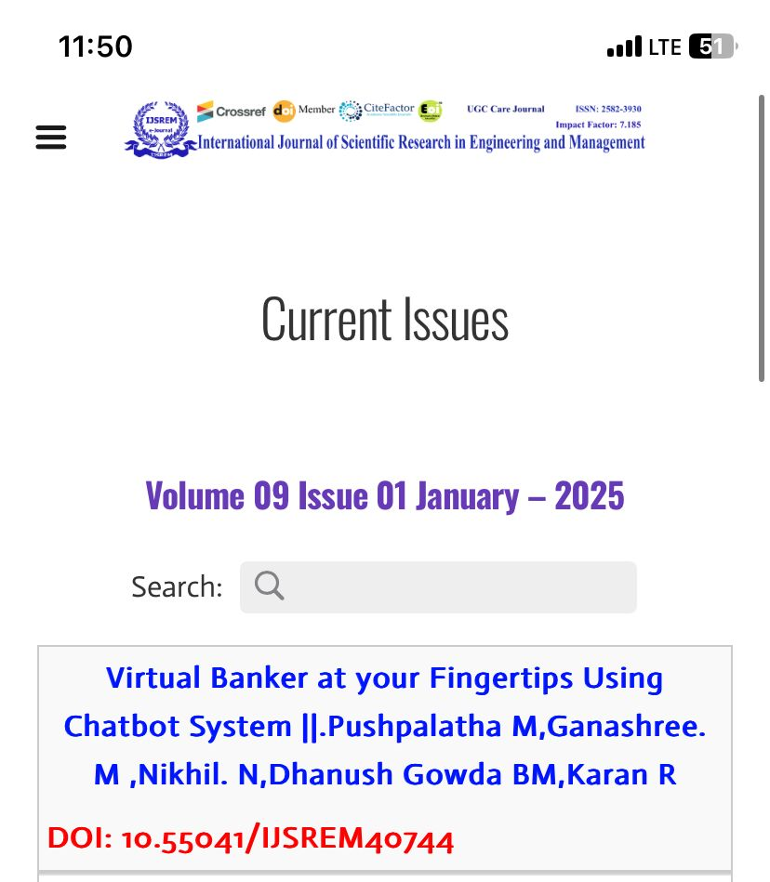
Publication Details
https://ijsrem.com/submit-research-paper-online/?gad_source=1&gclid=CjwKCAiAgoq7BhBxEiwAVcW0LA-bUurGTvCxAsc5GTaTBhX03XD_u2iAZ9vp7A2KhPQnIX_N02S0bxoCkmQQAvD_BwE

Slide 15
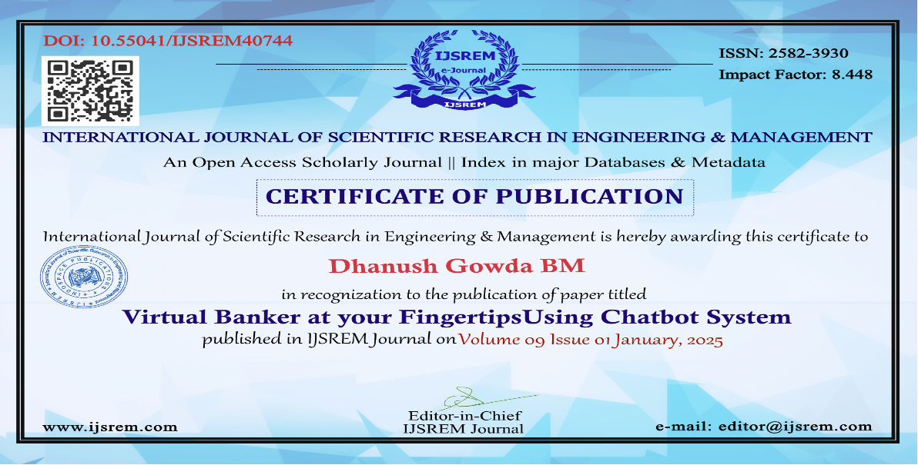
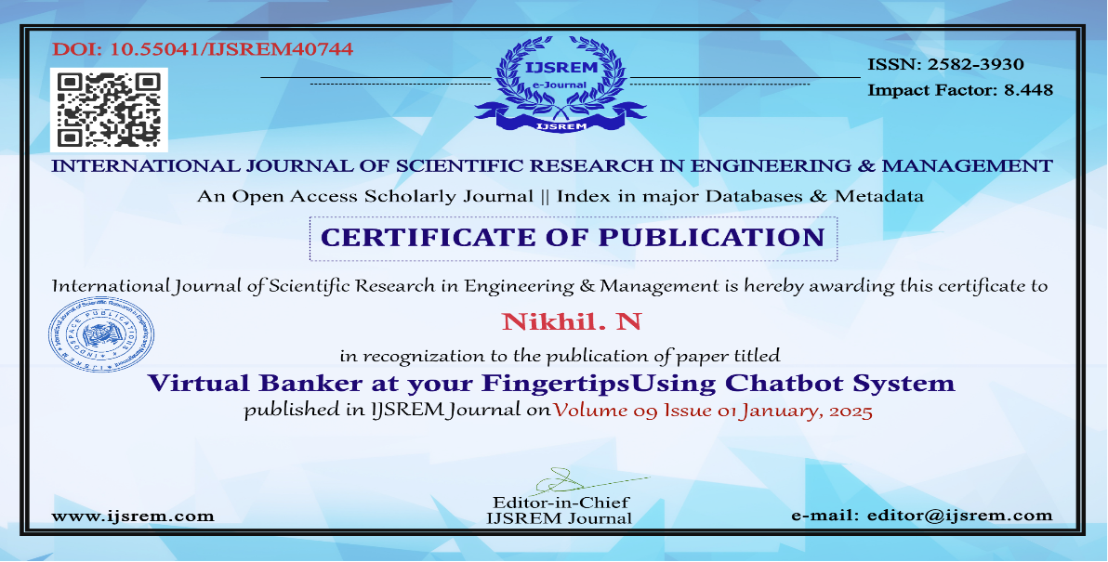
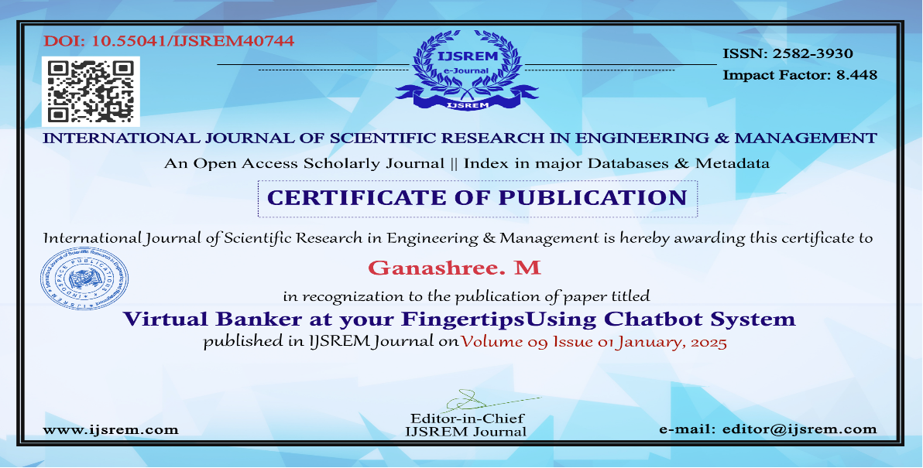


Slide 16
Thank You

